Slide 1
INFECTIONS IN IMMUNOCOMPROMISED HOST OTHER THAN HIV
PRESENTERS
Ali Hamad Simai
Halima Othman Suleiman
FACILITATOR: Prof. M. Bakari

Slide 2
OUTLINE
Introduction
Primary immunodeficiency
Secondary immunodeficiency
Overview of infections in immunocompromised host
References

Slide 3
Definition
“Infections occurring in patients with impaired immune function due to non-HIV causes, characterized by increased susceptibility to opportunistic and severe infections” (Harrison’s Principle of Internal Medicine; Mandell’s Infectious Disease)

Slide 4
Epidermiology
Recent high-quality epidemiology data show that a growing proportion of “opportunistic” infections now occur in non‑HIV immunodeficient/immunocompromised hosts (malignancy, transplant, biologics/steroids, critical illness).
With substantial mortality and shifting pathogen patterns particularly for invasive fungi and herpesviruses

Slide 5
Epidermiology…cont
Multicenter retrospective study across 46 hospitals (Australia/NZ) found 90% of cryptococcosis cases were HIV‑negative (426/475); 60.8% had an immunocompromising condition (cancer, transplant, other) and 1‑year mortality 20.9% in non‑HIV vs 21.7% in HIV (p=0.89). Clinical Infectious Diseases 2023. This directly quantifies the shifting burden to non‑HIV hosts in a modern era cohort. (Coussement, J. et al. (2023))
Notes:
Current Epidemiology and Clinical Features of Cryptococcus Infection in Patients Without Human Immunodeficiency Virus

Slide 6
Causes of immunodeficiency in non-HIV host
Disease related causes
e.g., Diabetes mellitus, Chronic kidney disease, malignancies (like leukemia)
Treatment-related causes
e.g., chemotherapy, corticosteroids, immunosuppressive drugs (post-transplant)
Congenital causes
e.g., primary immunodeficiency disorders

Slide 7
Classification
Primary vs Secondary immunodeficiency
Innate vs Adaptive defects
Notes:
Core textbooks :Harrison’s principles of internal medicine, Kuby immunology.
Guildlines and Authoritative organization: WHO(Secondary immunodefiency; HIV, malnutrition, International union of immunological societies(primary immunodefiency diseases

Slide 8
Type of primary immunodeficiency | Disease
Predominant T Cell Disorders | De George Syndrome
Predominantly B Cell Disorders | X-linked Agammaglobulinaemia (XLA)/Bruton’s Disease.
 | Selective IgA deficiency
 | Hyper IgM syndrome
Combined Immunodeficiency Disorder | Severe Combined Immunodeficiency (SCID)
 | Ataxia-Telangiectasia
 | Wiskott-Aldrich Syndrome
Phagocytic cell immune defects | Leukocyte adhesion defects
 | Chronic granulomatous disease
 | Chediak-Higashi Syndrome
Complement disorders | C1 esterase inhibitor deficiency
 | Complement component deficiency
Defects in natural killer cells | Ataxia telangiectasia-
 | Severe congenital neutropenia
Notes:
Classic triad of De George Syndrome (Cardiac defects, hypocalcemia and T-cell deficiency)

Slide 9
Primary immunodeficiency
When primary immunodeficiency should be suspected in adult?
Any one of the following.
≥4 infections requiring antibiotics in a year(e.g. sinusitis, pneumonia)
Recurring infection requiring IV antibiotics
Infections with unusual localization or pathogen e.g. PJP
Recurrent deep abscesses
Chronic diarrhea i.e. due to cryptosporidiosis
Recurrent, prolonged, unexplained fever
Family history of primary immunodeficiency
European Society for Immunodeficiency(ESID)
Notes:
Even when primary immunodeficiency is highly suspected, still evaluate for secondary immune disorders , as they are more common

Slide 10
Common Variable immunodeficiency
Defective B cell function leading to hypogammaglobinemia (low IgG, often with low IgA/IgM) and impaired antibody responses.
Affects approximately 1 of 25000 individuals.
Commonly diagnosed after puberty, especially between 20 and 45 years of age.
Approximately, 20% of CVID patients have a first-degree family member with a selective IgA deficiency.
The genetic influence in CVID is believed to cause an intrinsic B cell defect (CD19-deficiency by mutations in CD19; 16p11.2).
Notes:
New England Journal of Medicine,Tangye SG,et al.Human inborn errors of immunity:2022 update

Slide 11
CVID – clinical manifestation
Recurrent Sinopulmonary infection: pneumonia, bronchitis, sinusitis, Otitis, Conjunctivitis, Septic arthritis, Bacterial meningitis.
Autoimmunity in approximately 20%
Persistent diarrhea and malabsorption caused by giardiasis, C.difficile infection, bacterial enterocolitis, CMV colitis, H. pylori infection
Malignancies; the risk of gastric carcinoma is almost 50 times greater in patients with CVID

Slide 12
CVID – Diagnosis
Diagnostic criteria according to ESID- 2026
A diagnosis of CVID requires ALL core immunological criteria + exclusion of secondary causes, plus typical age and immune profile requirements.
1. Hypogammaglobulinemia (essential criterion)
Serum IgG markedly reduced
  ≥ 2 standard deviations below age-adjusted normal
  Confirmed on at least 2 separate measurements
Low IgA is required
  ↓ IgA is mandatory in ESID definition
IgM may be low or normal
Notes:
ESID:EUROPEAN SOCIETY FOR IMMUNODIFFICIENCY

Slide 13
2. Impaired specific antibody function
At least ONE of the following:
Poor or absent response to vaccines
(e.g., pneumococcal, tetanus, diphtheria)
OR absent isohemagglutinins (anti-A/anti-B antibodies)
OR reduced switched memory B cells
  typically <70% of age-adjusted normal

Slide 14
3. Age criterion
Onset of disease after 4 years of age
  (symptoms may start earlier, but diagnosis must be ≥4 years)
4. No profound T-cell deficiency
CVID is primarily a B-cell/antibody disorder.

Slide 15
5. Exclusion of secondary causes
Must exclude other causes of hypogammaglobulinemia:
HIV infection
Protein loss (nephrotic syndrome, protein-losing enteropathy)
Hematologic malignancy (CLL, lymphoma)
Immunosuppressive drugs (rituximab, steroids, chemotherapy)
Other defined primary immunodeficiencies

Slide 16
6. Clinical features (supportive but commonly required in ESID registry definition)
At least ONE of:
Recurrent or severe infections
Autoimmune disease (e.g., ITP, autoimmune hemolytic anemia)
Granulomatous disease
Unexplained polyclonal lymphoproliferation
Family history of antibody deficiency

Slide 17
CVID – Treatment
Immunoglobulin replacement :IVIG(400-600 mg/kg every 3- 4 weeks) or SCIG( Weekly) goal is IgG > 5-6g/L reduce infections monitor IgG level every 6months.
Infections and antimicrobials: Antibiotics
Autoimmune disorders - Glucocorticoids are the first-line treatment, refractory cases, rituximab
Vaccinations: Inactivated only

Slide 18
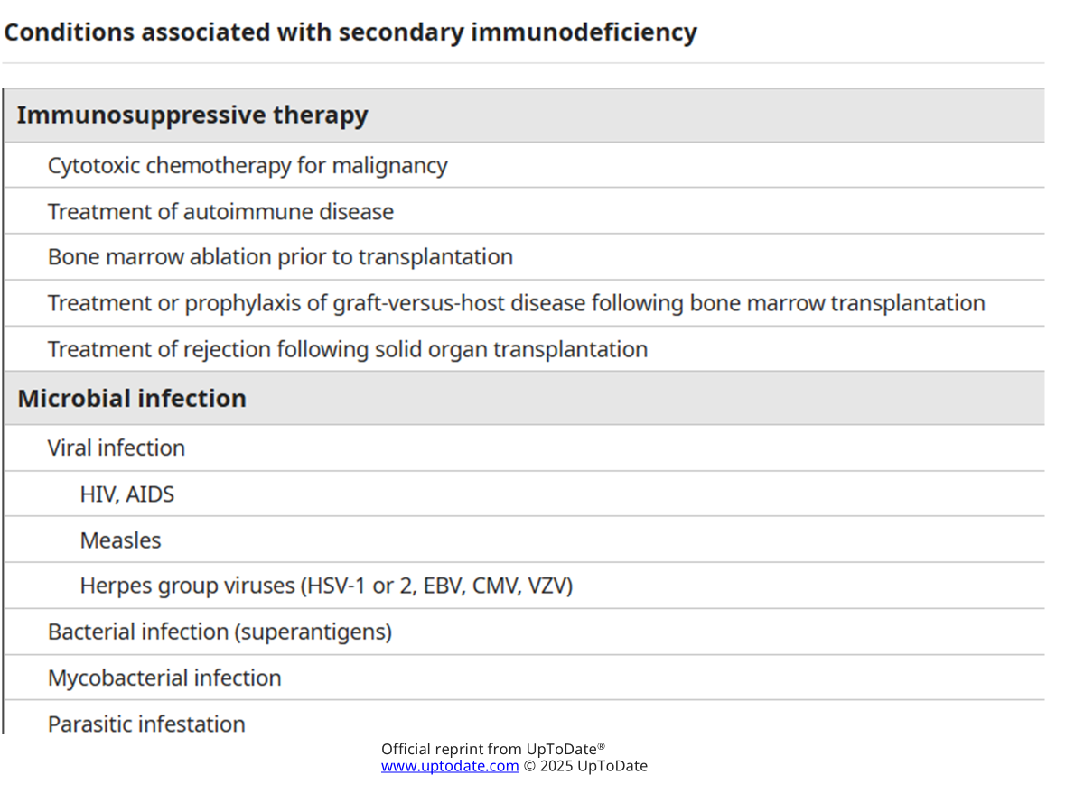
SECONDARY IMMUNODEFICIENCY

Slide 19
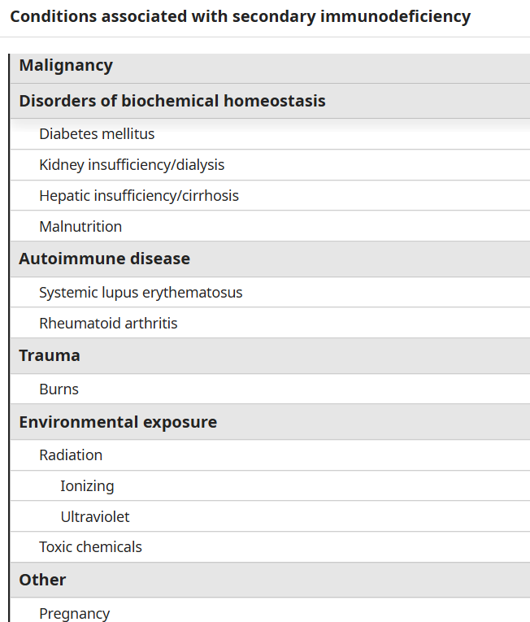

Slide 20
Diabetes mellitus
In both types, there is 1.5 – 4 folds increased risk of infection.
Pneumonia, skin infection and UTI: 2-3 times
Vascular insufficiency, neuropathy and altered skin, mucosal, and gut microbial colonization contribute to the increased risk of infections
Poor glycemic control : 2-6 folds
Increased binding between Candida and epithelial cells of the oral mucosa and vagina
Good culture media for bacteria and other microorganisms
Notes:
New England Journal Medicine, Indian journal of Endocrinology and metabolism, American Diabetes Association(2024-2025)

Slide 21
End-stage renal disease
ESRD causes both innate and adaptive immune dysfunction
Uremia related immune dysfunction
Dialysis related factors
Nutritional and metabolic factors

Slide 22
End-stage renal disease
Overall infection risk in ESRD is approximately 3-5 folds
Infection is second leading cause of death in dialysis patients
Hospitalization for infection is 2-3 times
Bloodstream infection; S.aureus bacteremia (100-400 times)
Notes:
Frontiers in Medicine 2025,Nature Scientific Reports(2020),Ishani A et al.,JASN(2005)

Slide 23
Chronic active hepatitis and cirrhosis (advanced liver disease)
Cirrhosis associated immune dysfunction(CAID)
The liver is the primary site of C3 synthesis, in severe liver failure, opsonization of bacteria is impaired
Impairment part of RES, high risk for blood-borne pathogens
High risk of spontaneous bacteria peritonitis(SBP), Pneumonia and UTI.

Slide 24
INFECTIONS IN HEMATOPOIETIC CELL TRANSPLANT(HCT) RECIPIENT
Main stay for SCD, Aplastic anemia and other blood cancers
HCT recipients, are at substantial risk infections especially allogenic transplants.
Infections account for approximately 21% of deaths post-allogeneic HCT.
Bacterial infections major complication mainly bloodstream infections, pneumonia followed by GIT infections.
World Network for Blood and Marrow Transplantation(WBMT) – global transplant activity2024

Slide 25
INFECTIONS IN HCT CONT…
Phases of Infection risk:
  Pre-engraftment (Days 0–30): Predominantly bacterial infections due to severe neutropenia(ANC< 500/µl) as a result of high dose chemo and radiation
  Early Post-engraftment (Days 30–100): Viral reactivations and fungal infections become more common. Recovery neutrophil but B cells and T cells not yet recovered( increased CMV, EBV,HHV-6,adenovirus)
  Late Post-engraftment (>Day 100): Chronic Graft versus Host Disease (GVHD) and long-term immunosuppression increase risk for opportunistic infections.￼
Notes:
Graft Versus Host Disease life threatening complication after certain stem cell and bone marrow transplants, occur in allogenic transplant, transplanted cell regard the recipient as foreign and attacks the recipient’s body can be acute with abdominal pain, jaundice, skin rash, itching and increased risk of infection, can be chronic with dry eyes, dry mouth, fatigue, joint pain, stiffness

Slide 26
INFECTIONS IN HCT RECIPIENT - PREVENTIVE MEASURES
Immunizations: Initiate inactivated vaccines starting at 6–12 months post-HCT, including pneumococcal, H.influenza b, and influenza
Fluoroquinolone prophylaxis (e.g., levofloxacin) is recommended during anticipated neutropenic periods ≥7 days.(guided by local resistance pattern)
PJP Prophylaxis with TMP-SMX for at least 6 months post-transplant or during immunosuppressive therapy.
Antiviral Prophylaxis: Consider for HSV and VZV, especially in patients with chronic GVHD. Valacyclovir..!
Monitoring and Surveillance: Regular screening for CMV and other opportunistic infections
Notes:
Christofferson et al.,2025(systemic review) immunocompromised patients show prolonged viral shedding increased transmission risk and delayed viral clearance

Slide 27
INFECTIONS IN SOLID ORGAN TRANSPLANT (SOT) RECIPIENT
Lifelong immunosuppression
Hospital exposure
Surgical disruption and ischemia
Opportunist pathogen reactivation
Up to 60% recipients experience at least one infection within initial year following transplant.(Delden et al)
Infection in SOT are diverse, non-specific symptoms, complex antimicrobial choice

Slide 28
RISK OF INFECTION FOLLOWING SOT
Infection in SOT is determined by the synergy between two factors;
  Epidemiologic exposure- contact, latent pathogen, nosocomial, OI
  Net state of immunosuppression-Type, dose, duration, commodifies, invasive devices

Slide 29
TIMING OF INFECTIONS POST SOT
1st month after SOT- pre-existing infections from donor or recipient, nosocomial infections i.e. related to surgery, catheter
1st-6thmonth after SOT- Effect of IS is maximal
  OI (viral-CMV,EBV,VZV. Fungal aspergillus, cryptococcus, PJP. Protozoa especially Toxoplasmosis)
  Prevention of infections in this period is the basis of prophylactic antimicrobial strategies.
6th -12month –most patient receive reduced level of immunosuppression, susceptible to community acquired pneumonia due to Virus, Legionella

Slide 30
PROPHYLAXIS IN SOT
Pretransplant, peritransplant and post transplant
Pretransplant prophylaxis:
  thorough medical history, previous infection and immunization records.
Peritransplant: - pancreatic transplant( increased risk of candida spp) fluconazole prophylaxis recommended, through wound care –SSI
Post transplant (increased risk of nosocomial and OI): PJP prophylaxis TMP-SMX first line, CMV – Valganciclovil

Slide 31
INFECTIONS IN CANCER PATIENTS ON CHEMOTHERAPY
Cancer patients are at an increased risk of developing infections that are primarily treatment driven but may also be malignancy driven
Systemic cytotoxic therapy affect
  Myelopoiesis -Neutropenia
  Integrity of GI mucosa - risk for invasion by normal flora that translocate across intestinal mucosal surfaces
Fever may be earliest and only sign of infection
It is critical to recognize neutropenic fever early and initiate empiric systemic antibacterial therapy promptly

Slide 32
INFECTIONS IN HEMATOLOGIC MALIGNANCIES cont..
Multiple myeloma
Malignant B-cell clone can displace other B cells, leading to humoral immune deficiency
Myeloma cells secrete TGFβ and VEGF which suppresses the inflammatory responses and decreasing antigen presentation for adaptive immunity.
Patient with MM have an increased risk for encapsulated bacteria infections such as pneumococci
Widespread immunologic dysfunction is likely be the result of chemotherapy

Slide 33
INFECTIONS IN SYSTEMIC LUPUS ERYTHEMATOSUS (SLE)
The reported immune dysfunctions in SLE includes
  Inherited complement deficiencies
  Abnormalities of chemotaxis and phagocytosis
  Defects resulting from immunosuppressive therapy
These immune abnormalities are more pronounced during periods of increased disease activity

Slide 34
INFECTIONS IN SLE cont…
Common bacteria, Gram positive and Gram negative
Severe manifestations of infection during disease flare
Encapsulated bacteria (S. pneumoniae, N. meningitidis) can cause meningitis and sepsis.
OI occur in patients who are treated with high-dose corticosteroids and/or additional immunosuppressive such as cyclophosphamide
Notes:
OI :Opportunistic infection
Disease flare: when there is reactivation of disease where complements are low, leukopenia

Slide 35
Neutropenic fever
Definition
Fever (≥38.3°C/101°F or ≥38.0°C/100.4°F for ≥1 h) (IDSA)
Neutropenia: ANC <1.0 x10^{9 /L}
Severe neutropenia: ANC <0.5x10⁹ /L
Profound neutropenia: ANC < 0.1 X10⁹/L
Notes:
a single ora

Slide 36
Neutropenic fever
Pathophysiology
Decreased neutrophil production
  Marrow: leukemia, lymphoma, myelodysplastic syndromes, infection, aplastic
  Iatrogenic: cancer chemotherapy, radiation, drugs
  Nutritional deficiencies: vitamin B12, folate
Increased peripheral neutrophil destruction
  Autoimmune: Felty’s syndrome, SLE, antineutrophil antibodies
  Splenic sequestration
Notes:
Felty syndrome:triad of (rheumatoid arthritis,splenomegaly and neutropenia)

Slide 37
Neutropenic fever
Epidemiology/Etiology
Most common life-threatening complication of cancer therapy
Causative organism identified only 1/3 of the time ; GN (especially Pseudomonas) cause severe infections
GP more common now
Fungal superinfection if neutropenia prolonged or if concurrent antibiotic use (especially Candida, Aspergillus)
Associated with IV lines, mucosal or GI infection.
Notes:
GN:gram negative

Slide 38
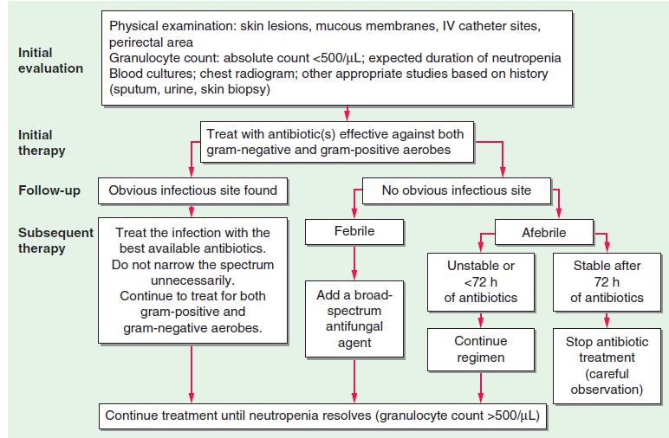
Management approach to patient with febrile neutropenia

Slide 39
Treatment/Management
Depend on low risk (MASCC score >21) or High (MASCC SCORE <21)
Low risk (OPD) recommended ciprofloxacillin orally plus amoxicillin and clavulanic acid
High risk (IP) IV antibiotic with antipseudomonal activity i.e. Cefepime 2g tds or IV piperacillin plus tazobactam 4.5g or Meropenem 1g tds IV
Empirical antifungal in high risk with fever 4-7 days
IDSA/ASCO guideline
Notes:
MASCC :Multinational association for supportive care in cancer
IDSA:IMMUNODEFIENCY SOCIETY OF AMERICA
ASCO:AMERICA SOCIETY OF CLINICAL ONCOLOGY

Slide 40
Prevention of febrile neutropenia
General measures, hygiene and infection prevention
Fluoroquinolones +antifungal prophylaxis for profound neutropenia
Co- trimoxazole prophylaxis for PJP
Vaccination
Prophylaxis with Colony stimulating factors ( CSF) if risk for febrile neutropenia >20% E.g Filgrastim or sargramostim
American society of clinical oncology (ASCO ) guideline

Slide 41
Overview of opportunistic infections in Immunocompromised
They are at risk of getting both community acquired and OI
  Bacterial infections
  Viral infections-CMV, VZV,HSV
  Fungal infections- Cryptococcal meningitis, PJP
  Parasitic infections- Toxoplasmosis

Slide 42
CMV INFECTION IN THE IMMUNOCOMPROMISED HOST
CMV is a herpes virus that establish lifelong latency, re activation can occur in immunocompromised individuals
High risk groups:
  SOT recipient
  HSCT recipient
  Hematological malignancy
  Individual on intensive IS
Independent risk factor for both graft loss and death
May result in fever and leukopenia, hepatitis, colitis, pneumonitis, esophagitis, gastritis, and retinitis

Slide 43
Diagnosis and monitoring
Cannot be diagnosed reliably on clinical grounds alone.
Screening- pre-transplant CMV serostatus assessment, CMV IgG
Monitoring- weekly monitoring during period of highest risk (first 3mo post SOT)
Diagnosis
CMV in blood by PCR along with ≥2 of the following :
  Fever ≥38C for ≥2 days.
  New or increased malaise
  Leukopenia or neutropenia on two separate, at least 24hrs apart
  Lymphocytosis of ≥5 percent.
  Thrombocytopenia
  Elevation of transaminases to ≥2 times
Notes:
Serology is more helpful when used to predict risk of CMV infection and disease in transplant recipients and is not recommended to diagnose acute disease

Slide 44
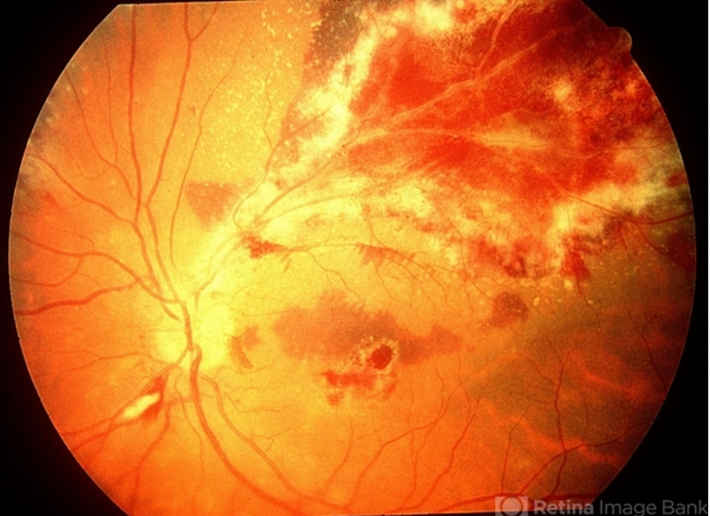
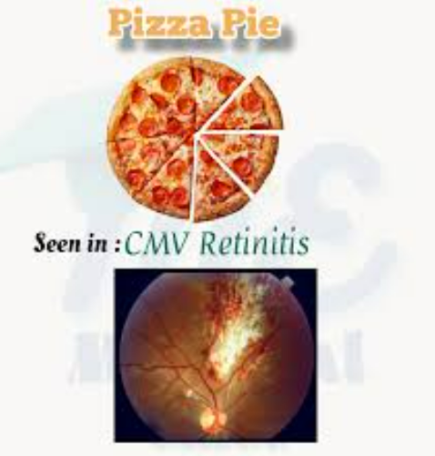
CMV retinitis on ophthalmoscope
Yellow- white retinal infiltrates with scattered hemorrhages resembling tomato sauce and cheese on pizza

Slide 45
CMV Prevention
VACCINES: no licensed CMV vaccine available, ongoing trials (moderna’s mRNA- 1647 closest to potential approval).
Prevention of CMV infection and disease in SOT and HSCT recipients is usually based on one of two methods:
universal prophylaxis or preemptive therapy.
With universal prophylaxis, antiviral drugs are used for a defined period, often 3 or 6 months with (Val)ganciclovir.

Slide 46
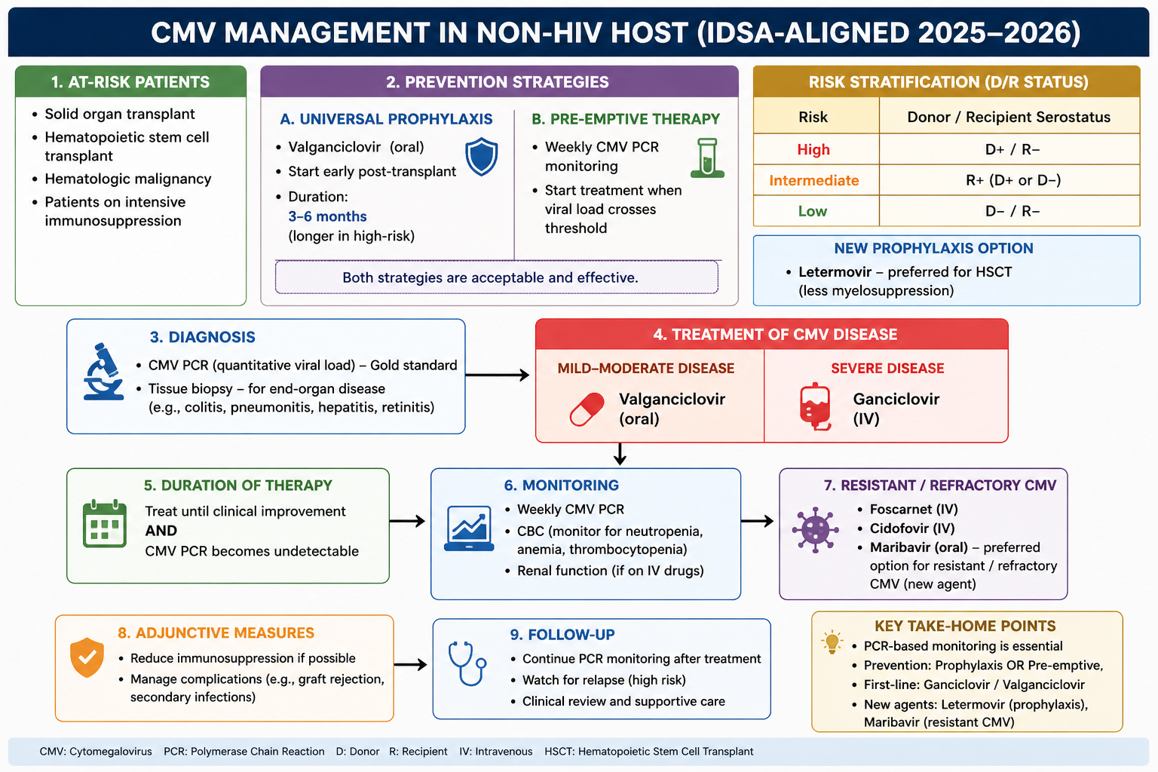
CMV- TREATMENT

Slide 47
CRYPTOCOCCAL MENINGITIS
Cryptococcal meningitis is a life-threatening fungal infection caused by the C.neoformans/C.gattii species
C. gattii has been highly associated with IS patients, especially those with anti-GM-CSF autoantibodies
Risk Populations:
Solid organ transplant recipients
Patients on immunosuppressive therapy (e.g., for autoimmune diseases)
Individuals with hematologic malignancies
Patients receiving immunomodulatory treatments

Slide 48
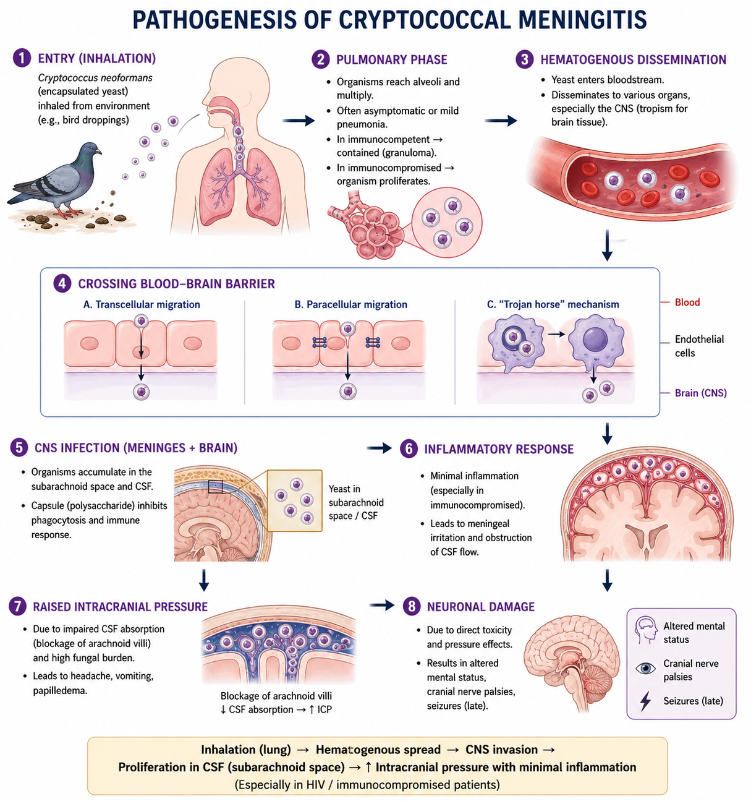

Slide 49
Investigations
1.Lumbar puncture-measurement of Cerebral Spinal Fluid (CSF) opening pressure and demonstration of positive CSF with Indian Ink preparation microscopy (<86% sensitivity), Low fungal burden ??- less than 42% in < 1000CFU Crypt culture.
2.Rapid CSF cryptococcal antigen (CrAg) assay
-Cost effective.
-persistence after antifungal therapy, can't differentiate relapse from IRIS
3.Rapid serum CrAg
- >99% sensitive when CSF CrAg is positive
4. Role of Cryptococcal culture , Role of PCR.
5.BRAIN-MRI

Slide 50
Treatment:3 phases
Induction Phase:
IV Amphotericin B 0.7-1mg/kg/day + oral 5flucytosine 100mg/kg/day for 7 days. Followed by 7 days of fluconazole 1200mg a day
In absence of 5 flucytosine; IV amphotericin B 0.7-1mg/kg/day for 14 days ( if liposomal amphotericin B 3-6mg/kg/day IV for 10 days) and fluconazole 1200mg od for 14 days
Consolidation Phase:
Fluconazole 800mg a day for 8 weeks​ or until CSF is sterile
Maintenance Phase:
Fluconazole 200mg per day for 6–12 months

Slide 51
Pneumocystic Jiroveci Pneumonia
PJP is a fungal infection of the lungs caused by Pneumocystis jirovecii, primarily affecting immunocompromised individuals.​
At-Risk Populations: SOT, HSCT recipients, Hematologic malignancy, patients on IS, primary immunodeficiencies​
Clinical Features: Progressive dyspnea, Fever, Non-productive cough, Oxygen desaturation​
Diagnostic Methods:
  CXR-Normal, bat wing appearance
  HRCT-diffuse ground glass opacities
  BAL –H&E stain, PCR or immunofluorescence staining
  Serum (1→3)-β-D-glucan assay, LDH

Slide 52
PJP Treatment
Non-severe cases TMP-SMZ 1920mg tds for 21 days.
Severe cases IV cotrimoxazole 5mg/kg TMP/75-100mg SMX/kg/day IV, administered 6-8hourly, switch to oral after clinical improvement
Alternative Agents:Pentamidine, Clindamycin+Primaquine, Atovaquone
Adjuvant therapy with steroids 40mg bid 5d, 40mg od 5d, 20mg od 11d PO/IV
Prophylaxis: TMP-SMX is recommended for high-risk patients
TMP-SMX 1tablet od PO alternatively, Dapsone 50mg bid PO​

Slide 53
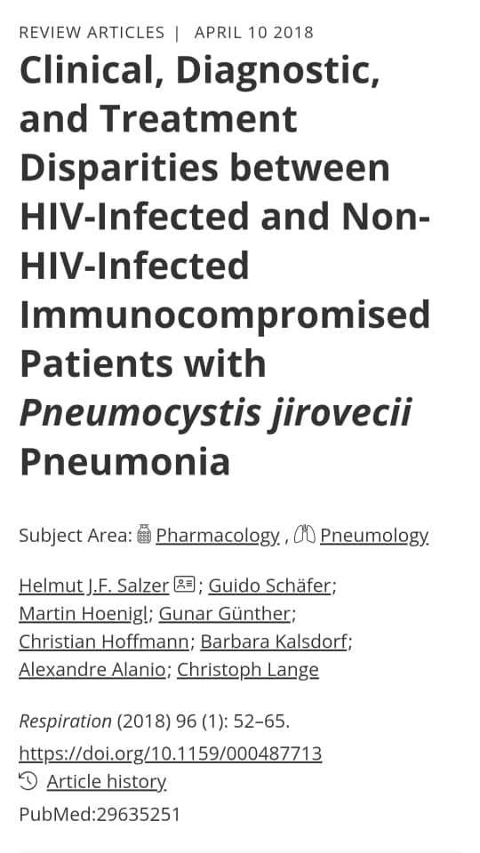
Aspect | Summary
Study type | Narrative literature review
Population size | The study reviewed multiple previously published studies involving HIV and non-HIV immunocompromised patients with PJP.
Study population | HIV-infected patients and non-HIV immunocompromised patients
Main Objective | To compare clinical presentation, diagnosis, treatment, and outcomes of PJP between HIV and non-HIV immunocompromised patients.

Slide 54
Major Findings / Outcomes of the Study
1. Disease severity differs significantly
Non-HIV patients developed:
  More acute disease
  Faster respiratory deterioration
  Severe hypoxemia
  Higher ICU admission rates
  Higher mortality
HIV patients had:
  Slower disease progression
  Higher fungal burden
  Better survival rates

Slide 55
Major Findings / Outcomes of the Study
2. Diagnostic differences
Diagnosis was easier in HIV patients because organism load is high.
Non-HIV patients often had:
  Lower organism burden
  Lower microscopy sensitivity
  Delayed diagnosis
PCR and β-D-glucan improved diagnosis especially in non-HIV patients.
3. Treatment outcomes
TMP-SMX remained the first-line treatment in both groups.
Adjunctive corticosteroids beneficial in severe disease.
Early treatment strongly associated with better outcomes.

Slide 56
Overall Conclusion
The review concluded that:
PJP in non-HIV immunocompromised patients is increasingly important clinically.
Non-HIV PJP is associated with worse prognosis and higher mortality.
Delayed recognition contributes significantly to poor outcomes.
Better prophylaxis strategies and earlier diagnosis are needed in non-HIV populations.

Slide 57
TOXOPLASMOSIS
T.gondii is an obligate intracellular protozoan parasite capable of causing severe infections in immunocompromised individuals.
A global meta-analysis reported a pooled prevalence of 35.9% for T. gondii infection in immunocompromised patients, compared to 24.7% in controls
Higher odds of infection observed in Cancer patients and
transplant recipients

Slide 58
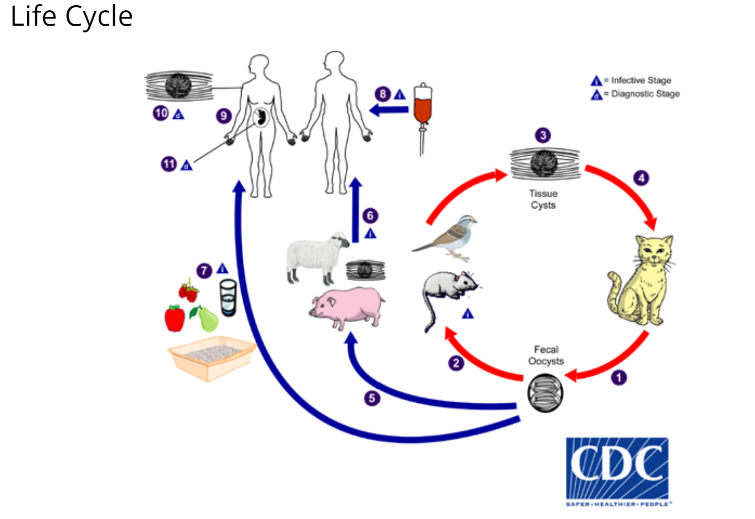
Notes:
Sexual cycle in Cat (definitive host) ingests bradyzoites raw meat, wild birds or mice In cat’s GIT bradyzoites develop into macro- & micro-gametocytes which fuse to form zygote zygote encapsulates → shed as oocyst via feces. Asexual cycle in Humans (mammals, birds) Ingest oocyst thru handling of contaminated soil/cat litter or water or food .Ingest bradyzoite from contaminated raw meat, wild birds or mice. Receive tachyzoite from unpasteurized milk, BT, organ transplant, mother-fetus (transplacentally, delivery)

Slide 59
Pathogenesis and clinical presentation
Immunocompromised hosts, lack of effective IFN-γ, impairs control T. gondii replication.
Deficiencies in Th1 responses and APC increase susceptibility
Reactivation leads to severe encephalitis and ocular toxoplasmosis.

Slide 60
Diagnosis and Management
Diagnosis involves serological testing (IgG, IgM), PCR assays, and imaging studies MRI (ring enhancing lesions;) CT Scan
Samples: CSF (lumbar puncture), amniotic fluid (amniocentesis), bronchoalveolar lavage fluid, blood, lymph node biopsy, n’ brain biopsy
Acute treatment-Sulphadiazine tabs 1gm 6 hourly + Pyrimethamine tabs 100mg loading dose, then 50mg /day + Folic acid tabs 10mg /day for 6 weeks. OR
Clindamycin capsules 450mg -600mg 6 hourly + Pyrimethamine tabs 100mg loading dose, then 50mg /day for 6 weeks.
Notes:
Skin test: delayed hypersensitivity to T. gondii may be useful for screening

Slide 61
Prevention
After six weeks of treatment: Give prophylaxis therapy with Sulphadiazine tabs 500mg 6 hourly + Pyrimethamine tabs 25-50mg /day + Folic acid tabs 10mg /day.
European guidelines recommend combining PCR screening with prophylaxis for hematopoietic stem cell transplant (HSCT) recipients .
Education on hygiene and food safety practices
Primary prophylaxis with Trimethoprim– TMP-SMX 160/800mg orally/day.
For those allergic to sulfur, give Dapsone tabs 50mg/day + Pyrimethamine tabs 50mg per week + Folic Acid tabs 10mg 3 times a week.

Slide 62
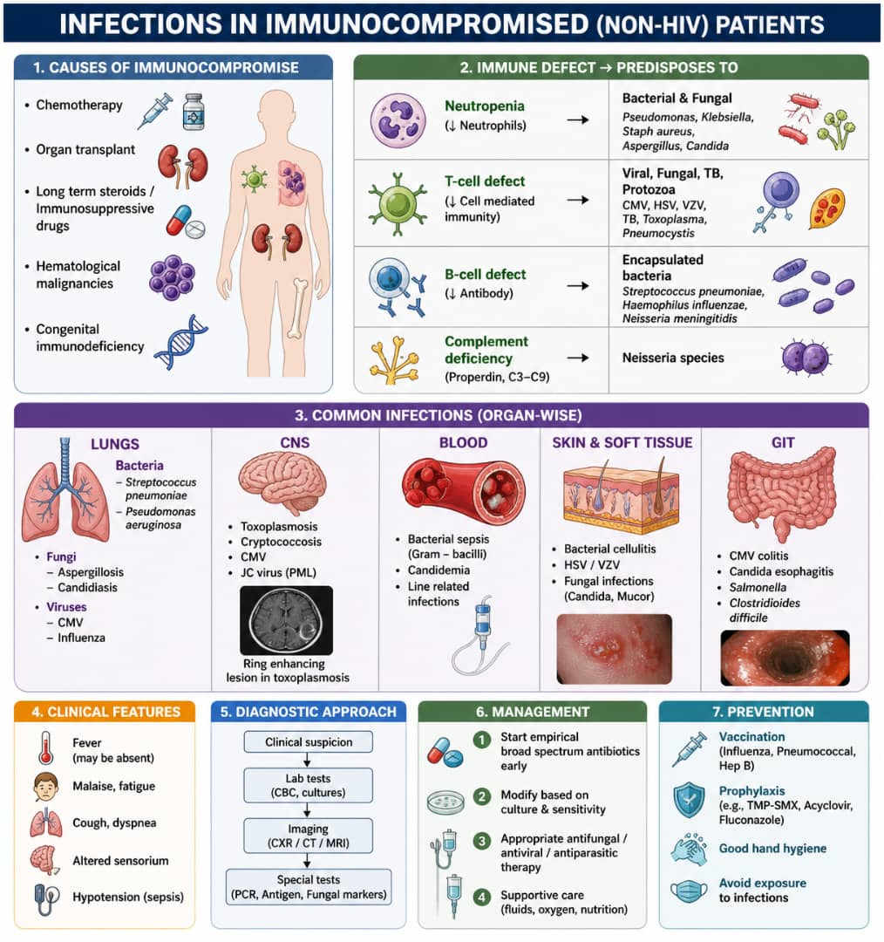

Slide 63
REFERENCES
European Association For The Study Of The Liver. EASL clinical practice guidelines on the management of ascites, spontaneous bacterial peritonitis, and hepatorenal syndrome in cirrhosis. Journal of hepatology. 2010 Sep 1
De Mattos ÂZ, et al. Albumin administration in patients with cirrhosis: Current role and novel perspectives. World journal of gastroenterology. 2022 Sep 7;28(33):4773.
Sickles EA, Greene WH, Wiernik PH. Clinical presentation of infection in granulocytopenic patients. Archives of Internal Medicine. 1975 May 1
Dropulic LK, Lederman HM. Overview of infections in the immunocompromised host. Diagnostic microbiology of the immunocompromised host. 2016 Aug 15:1-50
Joob B, Wiwanitkit V. Pneumocystosis pneumonia in immunocompromised patients. Pulmonology. 2020 Nov

Slide 64
REFERENCES
Holt, R.I.G., Cockram, C.S., Ma, R.C.W. et al. Diabetes and infection: review of the epidemiology, mechanisms and principles of treatment. Diabetologia 67, 1168–1180 (2024). https://doi.org/10.1007/s00125-024-06102-x
Limaye AP, Budde K, Humar A, Vincenti F, Kuypers DRJ, Carroll RP, Stauffer N, Murata Y, Strizki JM, Teal VL, Gilbert CL, Haber BA. Letermovir vs Valganciclovir for Prophylaxis of Cytomegalovirus in High-Risk Kidney Transplant Recipients: A Randomized Clinical Trial. JAMA. 2023 Jul 3;330(1):33-42. doi: 10.1001/jama.2023.9106. PMID: 37279999; PMCID: PMC10245286.
Mahsa Abassi et al, Cryptococcal Meningitis update on diagnosis and management-Current Tropical medicine Update 2020
Kasper D, Fauci A, Hauser S, Longo D, Jameson J, Loscalzo J. Harrison's principles of internal medicine, 21e. New York, NY, USA:: Mcgraw-hill; 2022.
Mark J. Sarnak, Bertrand L. Jaber, Mortality caused by sepsis in patients with end-stage renal disease compared with the general population, Kidney International, Volume 58, Issue 4, 2000,

Slide 65
REFERENCES
Coussement, J. et al. (2023)‘Current epidemiology and clinical features of cryptococcus infection in patients without human immunodeficiency virus: A multicenter study in 46 hospitals in Australia and New Zealand’,Clinical Infectious Diseases, 77(7), pp. 976–986.
Wang ZD, et al, Toxoplasma gondii infection in immunocompromised patients: a systematic review and meta-analysis. Frontiers in microbiology. 2017 Mar
Aerts R, et al, Guidelines for the management of Toxoplasma gondii infection and disease in patients with haematological malignancies and after haematopoietic stem-cell transplantation: guidelines from the 9th European Conference on Infections in Leukaemia, 2022. The Lancet Infectious Diseases. 2024 May

